Slide 1
The Facts of Lice
Everything you ever wanted to know about lice but were too shy to ask.

Slide 2
You’ve probably heard this before, but just as a reminder:
Lice CANNOT jump or fly
Lice CANNOT crawl across the classroom floor, up your chair, up your pants, up your shirt and to your head (that would be like you walking from Homer to Anchorage)
Lice DO NOT carry disease
Pets CANNOT give you lice
Lice live less than 48 hours off of a human scalp
Lice are VERY CLUMSY when they fall off a scalp
Lice LIKE TO STAY PUT on whichever head they have found. Read the following statistic from a peer reviewed study on lice:
“A healthy louse is not likely to leave a healthy head unless there is a heavy infestation. This is further illustrated by 2 studies from Australia. In 1 study, examination of carpets on 118 classroom floors found no lice despite more than 14000 live lice found on the heads of 466 children using these classrooms”

Slide 3
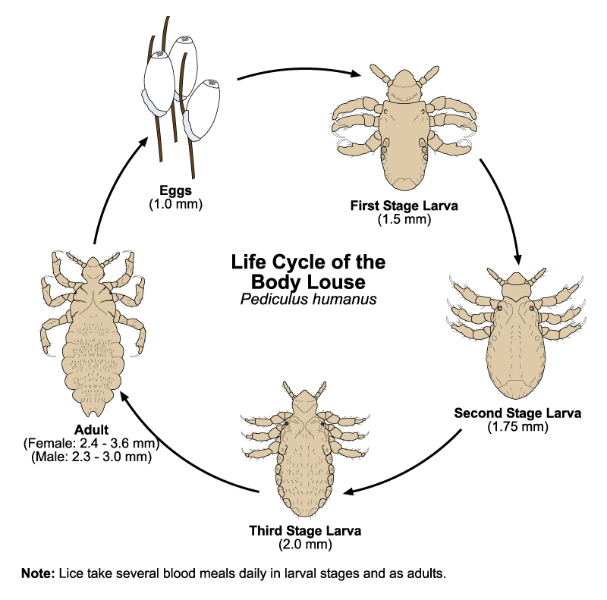
What do those little buggers look like?

Slide 4
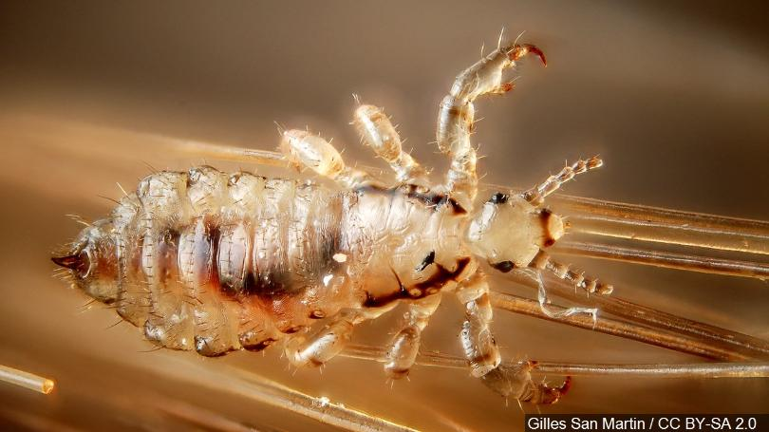
Just in case you weren’t sure what they look like
Cute huh?

Slide 5
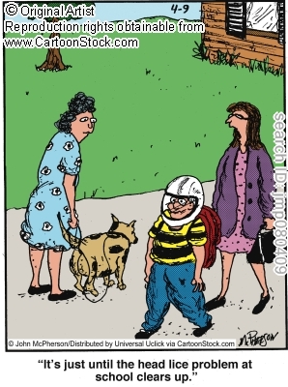
What can lice do?
Lice CAN gross people out
Lice DO make people anxious
Lice SOMETIMES make people itchy

Slide 6
Thanks for nothing…I’m still grossed out, anxious and really don’t want bugs in my classroom! I’m itchy just reading this.

Slide 7
There are Probably already lice in your classroom, maybe even on you!

Slide 8
That’s right, by the time a school nurse finds head lice on a child they have had lice for an average of 30 days! One whole month. Holy Moly.

Slide 9
Doing What’s best for kids
Lice do not cause disease. Sending students home with head lice causes that student to fall behind in their studies. Making parents leave work to come pick up their child can cause hardship in the home environment possibly even job loss. Basically, sending a kid home for head lice is not what is best for the child. That’s ultimately why we’re here right? To do what's best for the students.

Slide 10
Seriously?
So you’re telling me we’re just going to let lice run rampant in our schools and not do anything about it?

Slide 11
NO!!

Slide 12
We are updating our policy to reflect best practice and what’s best for families and students. We are recognizing that students who are found to have head lice have probably already been in school with lice for a month. Studies show that sending students home early the day lice are found does little to prevent the spread of lice.

Slide 13
Children found to have live head lice will be allowed to complete the school day and ride the bus home. The following will happen:
Their parent/guardian will be notified of the findings
Treatment advice will be given to the parent/guardian
The student will be allowed to return to school once their head has been successfully treated
If the student’s head was not successfully treated the parent will be requested to pick up the child and keep them home until treatment is successful.

Slide 14
But wait….there's more
We’re going to ask that teachers and staff remain just as vigilant as they have always been in identifying scratchy kids they think might have lice.
We’re going to ask that school staff keeps taking precautions to limit head to head contact and to ask kids to back up when they get a little too close.
Don’t allow children to share hats.
Don’t let kids take hats from the lost and found.

Slide 15
There's even more…
We will educate parents on head lice. We recognize that transmission and prevention of head lice starts at home not at school. We are going to ask parents to:
Start checking their children’s hair on a weekly basis for lice so it’s not a full blown infestation by the time the school finds them.
And we are going to help parents learn what to do by:
Educating them on lice recognition and treatment

Slide 16
I hope you feel a little better about head lice management in your classroom. If you have questions or concerns, or now feel itchy and want a head check, please contact your school nurse.

